Slide 1
An Introduction to Machine Learning
Mr. Zohaib Ahmed
Department of Software Engineering

Slide 2
Introduction to Machine Learning
Arthur Samuel (1959). Machine Learning: Field of study that gives computers the ability to learn without being explicitly programmed.
Definition by Tom Mitchell (1998): Machine Learning is the study of algorithms that
🞄 improve their performance P
🞄 at some task T
🞄 with experience E.
🞄 A well-defined learning task is given by <P, T, E>.

Slide 3
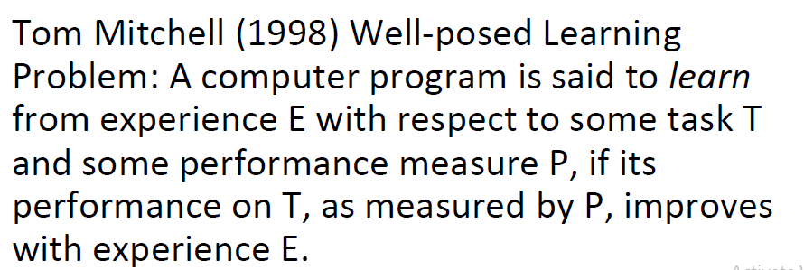
Introduction to Machine Learning

Slide 4
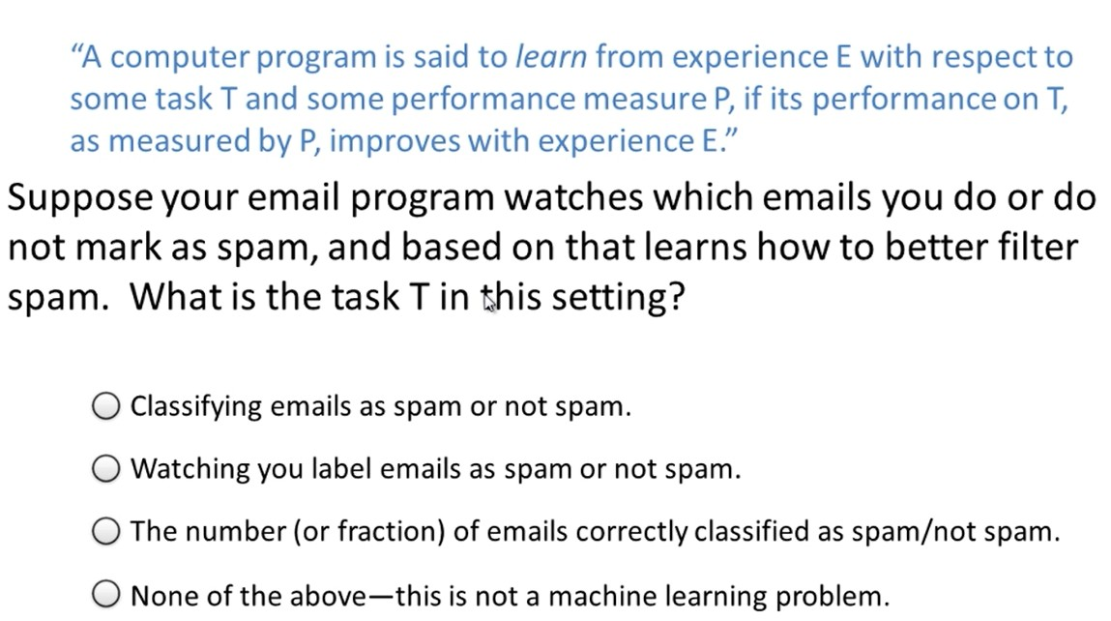
Introduction to Machine Learning

Slide 5
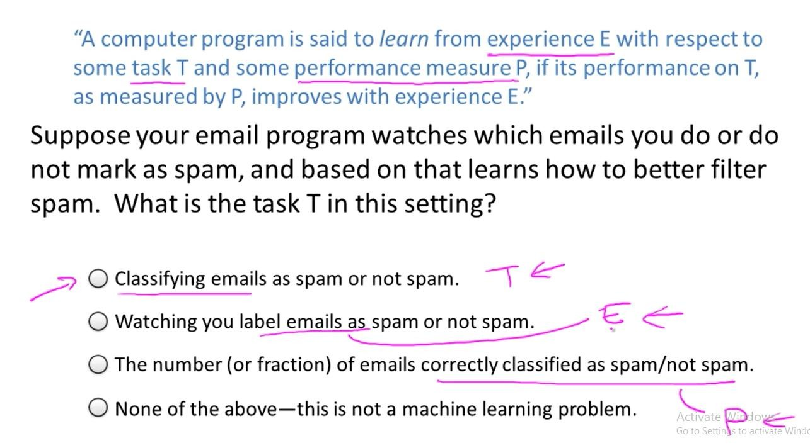
Introduction to Machine Learning

Slide 6
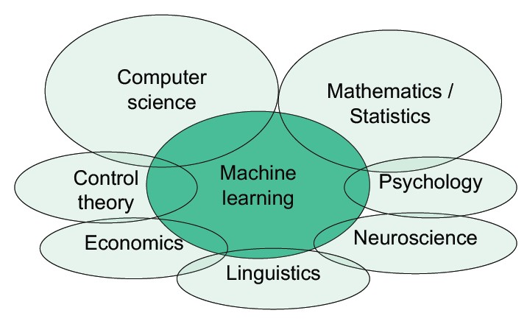
Introduction to Machine Learning

Slide 7
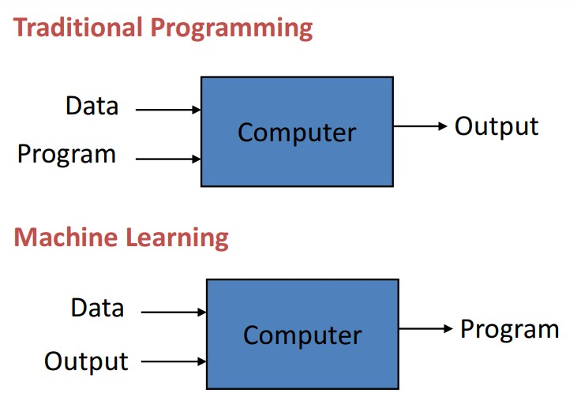
Introduction to Machine Learning

Slide 8
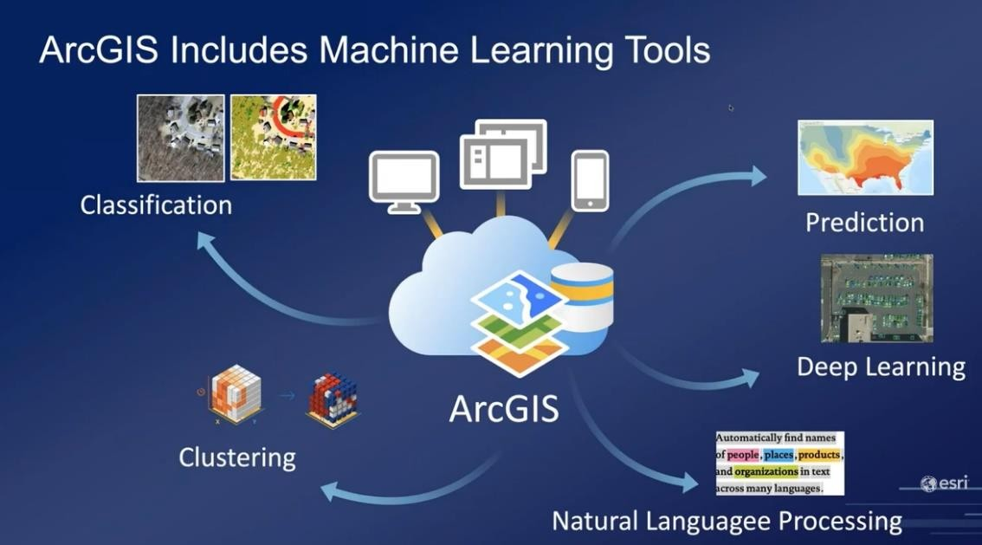
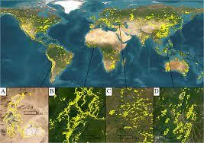
Applications for machine learning in data science
Regression and classification are of primary importance to a data
scientist
Finding oil fields, gold mines, or archeological sites based on existing sites (classification and regression)
Finding place names or persons in text (classification)

Slide 9
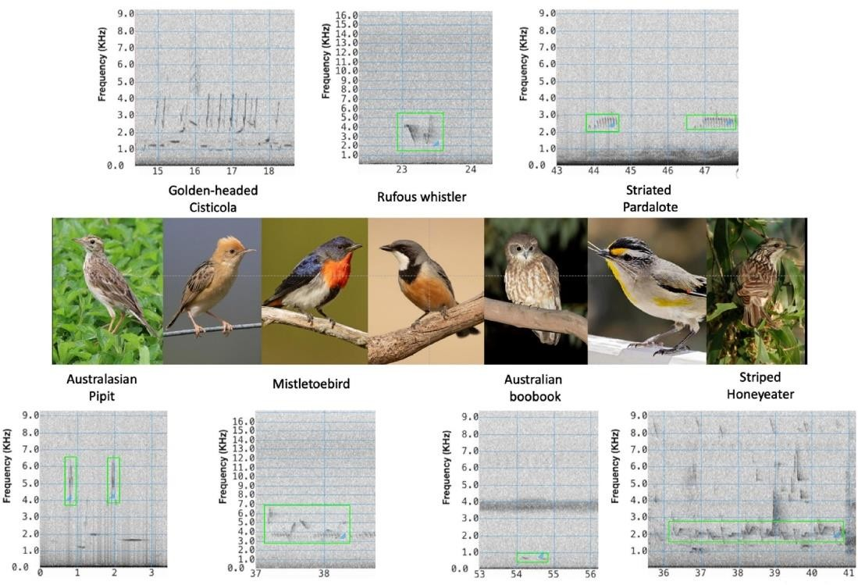
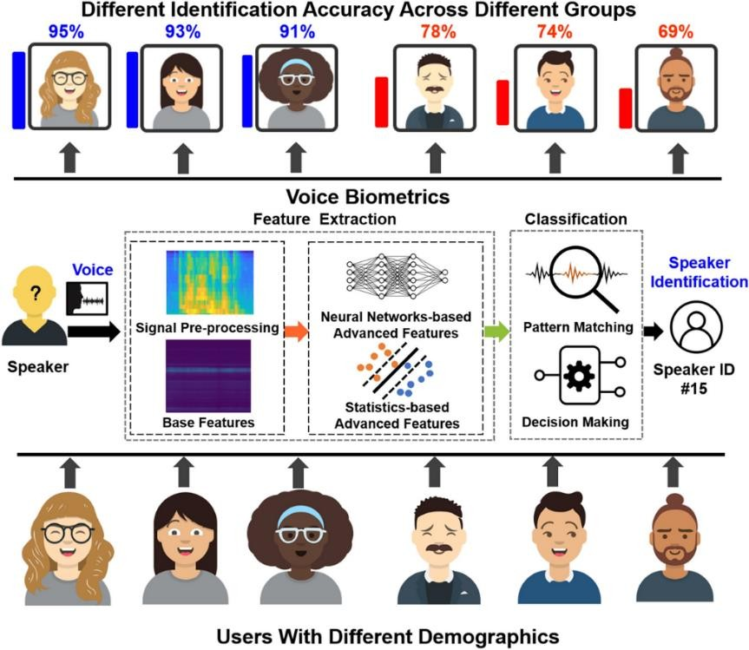
Applications for machine learning in data science
Identifying people based on pictures or voice recordings
(classification)
Recognizing birds based on their whistle (classification)

Slide 10
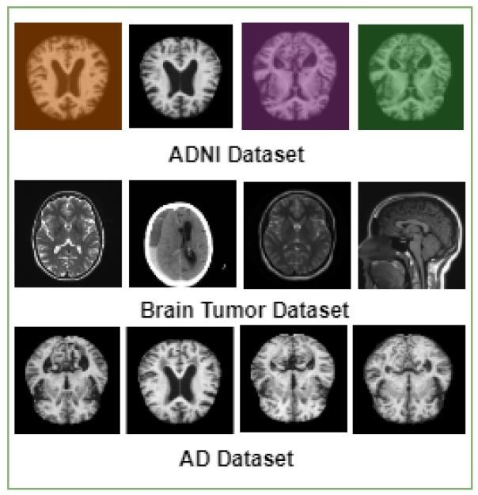
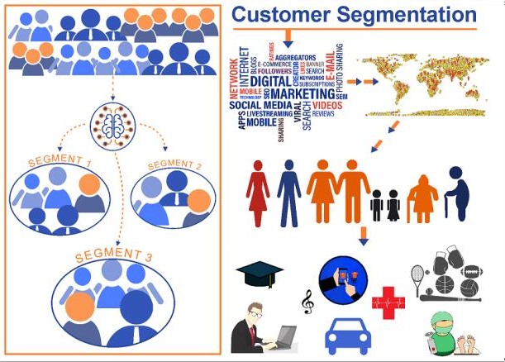
Applications for machine learning in data science
Identifying profitable customers (regression and
classification)
Proactively identifying car parts that are likely to fail (regression)
Identifying tumors and diseases (classification)

Slide 11
Applications for machine learning in data science
Predicting the money a person |  | amount of will spend on
product X (regression)
Predicting the eruptions of a period |  | number volcano in | of a
(regression)

Slide 12
Applications for machine learning in data science
Predicting your company’s
yearly revenue
(regression)
Predicting which team will win the Champions League in soccer
(classification)

Slide 13
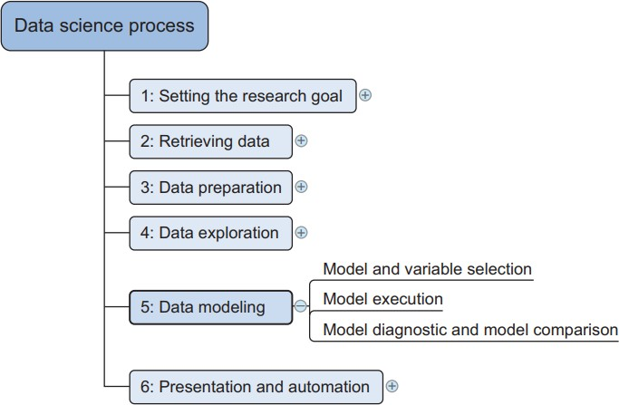

Slide 14
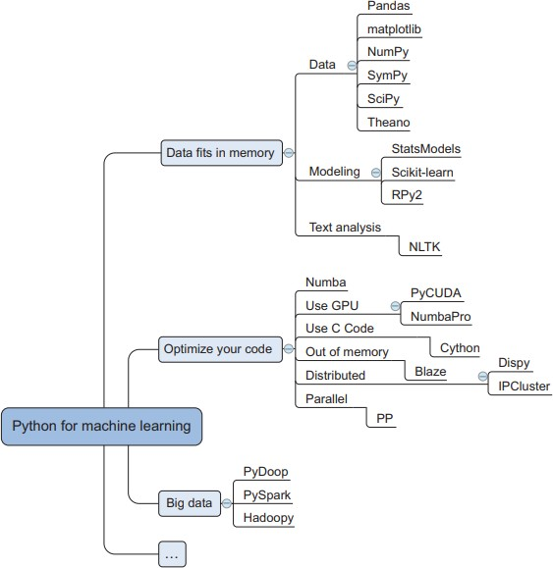

Slide 15
The modeling process
The modeling phase consists of four steps:
Feature engineering and model selection
Training the model
Model validation and selection
Applying the trained model to unseen data

Slide 16
Introduction to Machine Learning
Types of Learning
Supervised (inductive) learning – Given: training data + desired outputs (labels)
Unsupervised learning – Given: training data (without desired outputs)
Semi-supervised learning – Given: training data + a few desired outputs
Reinforcement learning – Rewards from sequence of actions

Slide 17
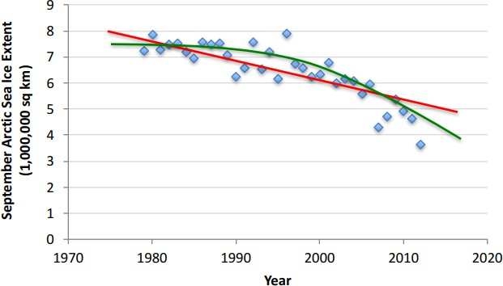
Introduction to Machine Learning
Supervised Learning: Regression
Given (x1, y1), (x2, y2), ..., (xn, yn)
Learn a function f(x) to predict y

Slide 18
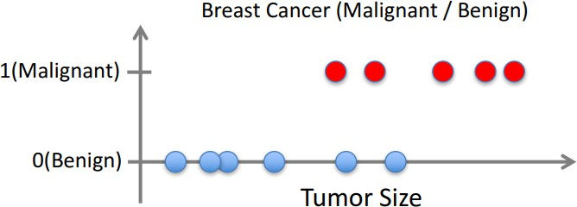
Introduction to Machine Learning
Supervised Learning: Classification
Given (x1, y1), (x2, y2), ..., (xn, yn)
Learn a function f(x) to predict y given x – y is categorical == classification

Slide 19
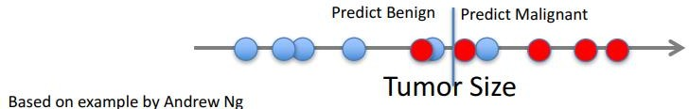
Introduction to Machine Learning
Supervised Learning: Classification
Given (x1, y1), (x2, y2), ..., (xn, yn)
Learn a function f(x) to predict y given x – y is categorical == classification

Slide 20
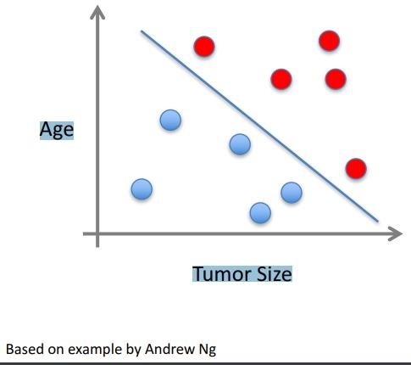
Introduction to Machine Learning
Supervised Learning
🞄 Tumor Size
🞄 Age
🞄 Clump Thickness
🞄 Uniformity of Cell Size
🞄 Uniformity of Cell Shape

Slide 21
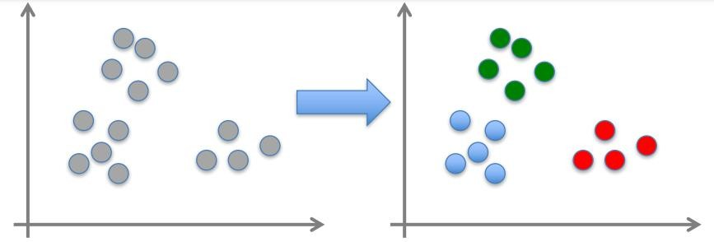
Introduction to Machine Learning
Unsupervised Learning
Given x1, x2, ..., xn (without labels)
Output hidden structure behind the x’s – E.g., clustering

Slide 22
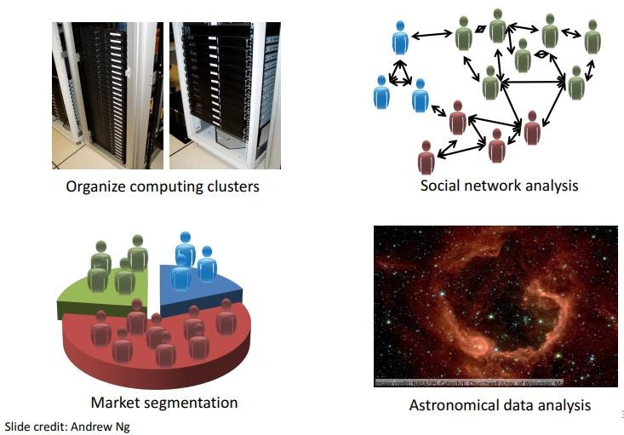
Introduction to Machine Learning
Unsupervised Learning

Slide 23
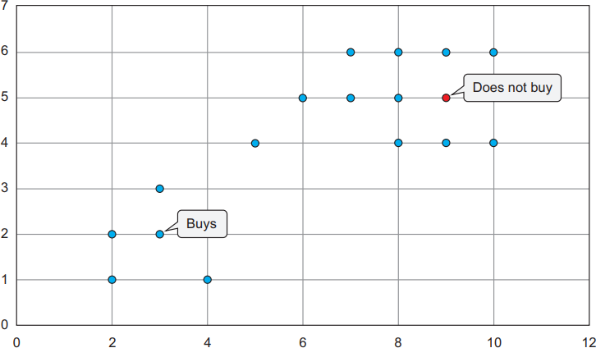
Introduction to Machine Learning
Semi-supervised Learning

Slide 24
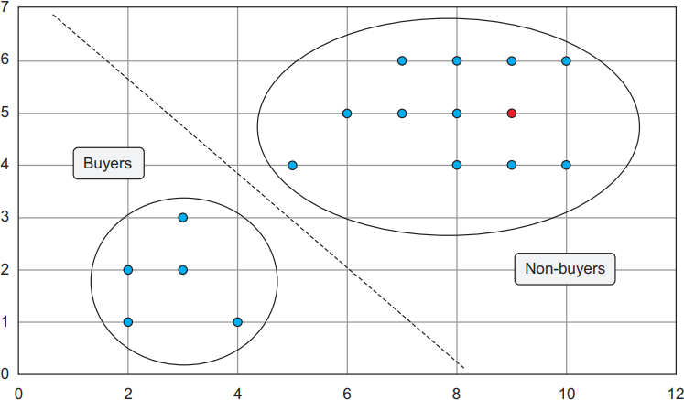
Introduction to Machine Learning
Semi-supervised Learning

Slide 25
Introduction to Machine Learning
Reinforcement Learning
Given a sequence of states and actions with rewards,
output a policy
– Policy is a mapping from states’ actions that tells you
what to do in a given state
Examples:
Credit assignment problem
Game playing
Robot in a maze
Balance a pole on your hand

Slide 26
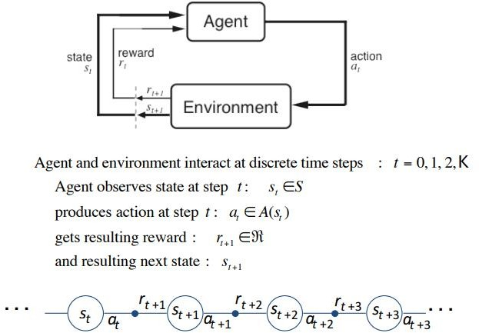
Introduction to Machine Learning
Reinforcement Learning - The Agent-Environment Interface

Slide 27
Introduction to Machine Learning
Evaluation
Accuracy
Precision and recall
Squared error
Likelihood
Posterior probability
Cost / Utility
Margin
Entropy
K-L divergence etc.

Slide 28
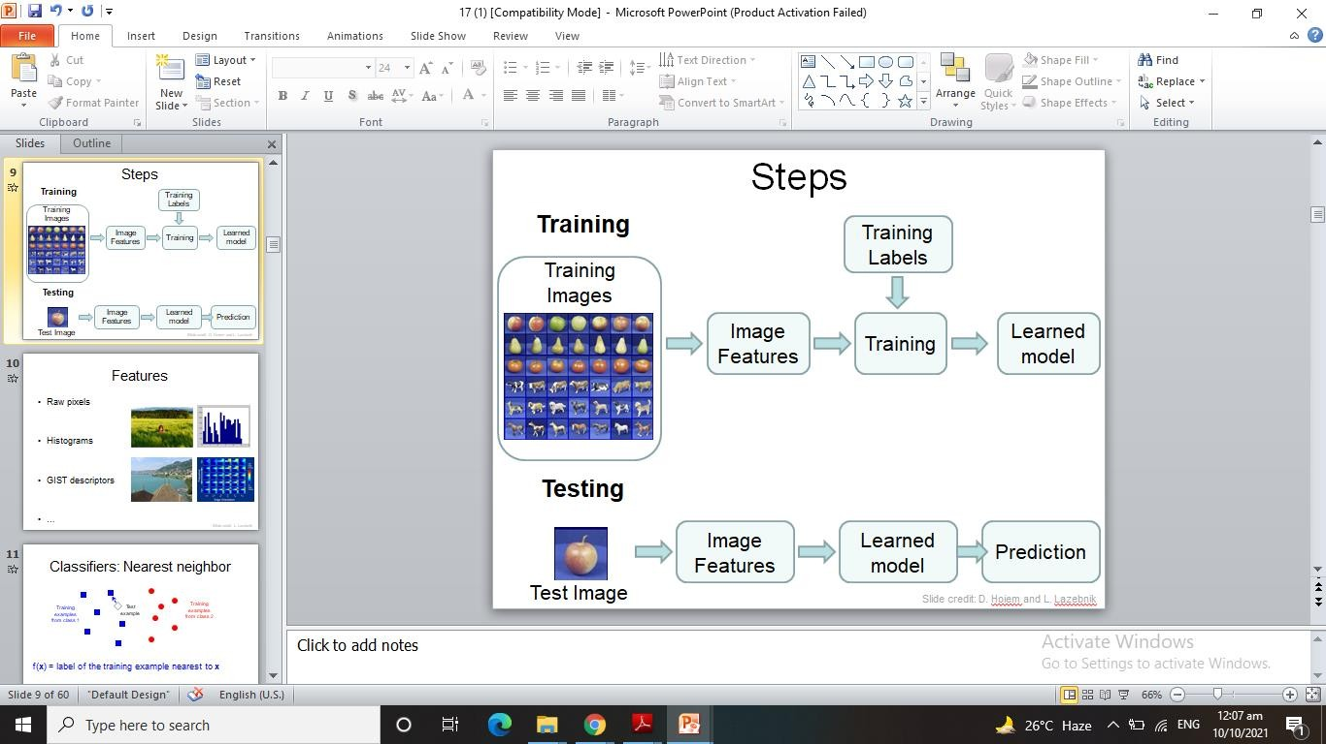
Introduction to Machine Learning

Slide 29

Introduction to Machine Learning - Classifiers: Nearest neighbor
Test example
Training examples from class 2
Training examples from class 1
f(x) = label of the training example nearest to x
All we need is a distance function for our inputs
No training required!

Slide 30

Introduction to Machine Learning - Classifiers: Linear
Find a linear function to separate the classes:
f(x) = sgn(w ⋅ x + b)
w is a weight vector
x is input vector
b is bias
Slide credit: L. Lazebnik

Slide 31
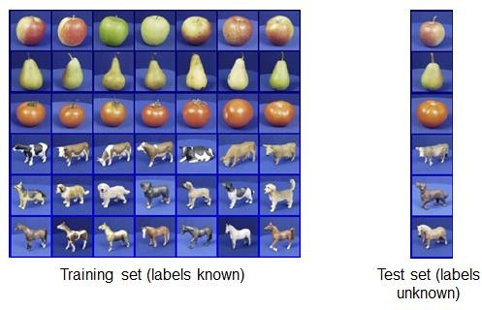
Introduction to Machine Learning - Generalization
How well does a learned model generalize from the data
it was trained on to a new test set?

Slide 32
Introduction to Machine Learning - Generalization
Components of generalization error
What is bias?
Bias is the difference between the average
prediction of our model and the correct value which we are trying to predict.
Model with high bias pays very little attention
to the training data and oversimplifies the model.
It always leads to high error on training and test data.

Slide 33
Introduction to Machine Learning - Generalization
Variance is the variability of model
prediction for a given data point or a
value which tells us spread of our data.
Model with high variance pays a
lot of attention to training data
and does not generalize on the data which it hasn’t seen before.
As a result, such models perform very
well on training data but has high error rates on test data.

Slide 34
Introduction to Machine Learning - Generalization
Underfitting: model is too “simple” to represent all the relevant class characteristics
🞄 High bias and low variance
🞄 High training error and high test error
Overfitting: model is too “complex” and fits irrelevant characteristics (e.g. noise) in the data
🞄 Low bias and high variance
🞄 Low training error and high test error

Slide 35
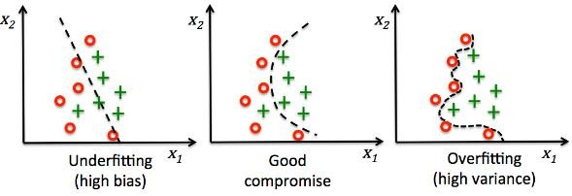
Introduction to Machine Learning - Generalization

Slide 36
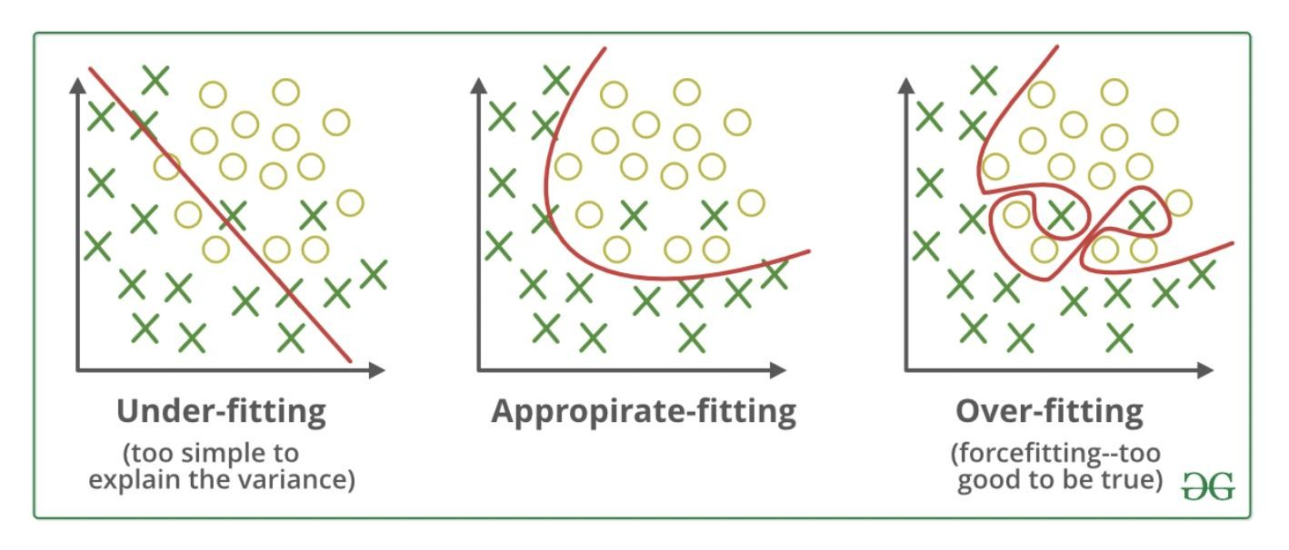
Introduction to Machine Learning - Generalization

Slide 37
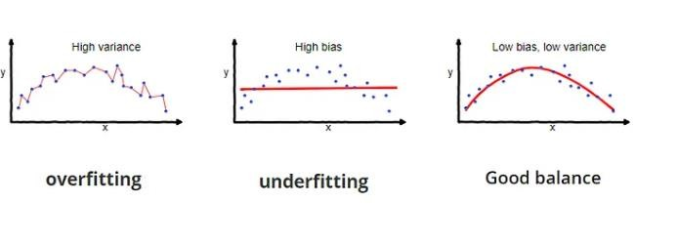
Introduction to Machine Learning - Generalization

